Slide 1
TESLA-Kit
Time-varying Emulator for Short- and Long-term Analysis of coastal flooding

Slide 2
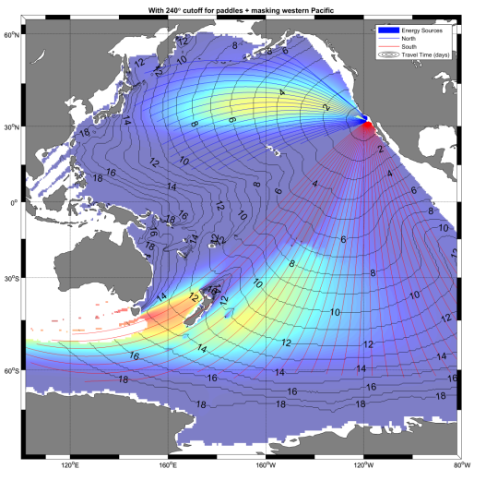
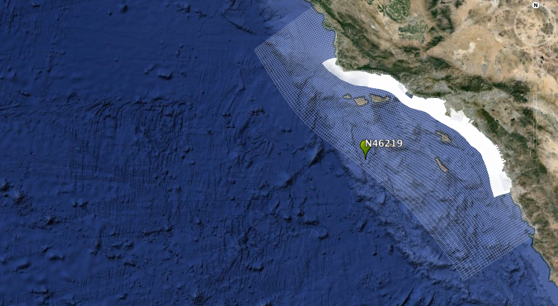
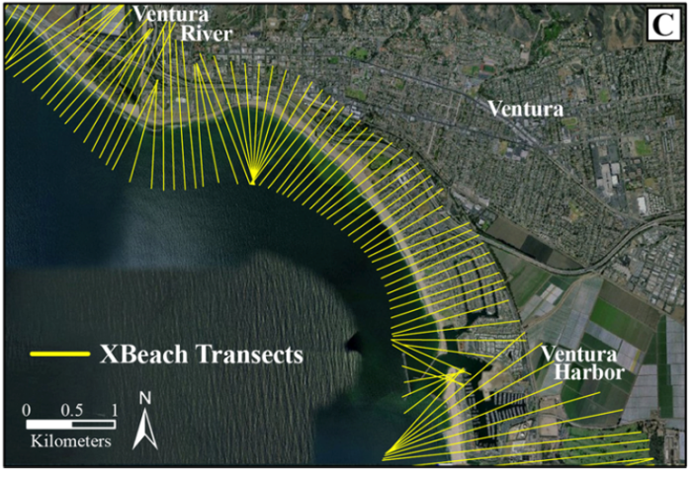
Regional Predictor
Hydraulic Boundary Cond.
Hybrid Downscaling
Extratropical Cyclones
MMSL
Selection
Annual Predictor
Xª
ET^{d}
Dynamic Downscaling (waves, tide, surge, IG waves, flooding)
Hs⁰ Tp⁰ Dir⁰
Hs¹ Tp¹ Dir¹
Hs² Tp² Dir²
η_{NTR}
Monthly Predictor
Daily Weather Types
X^{m}
DWT
Intraseasonal Pred.
X^{MJO}
Hs⁰ Tp⁰ Dir⁰
η_{NTR}
Meta-model
TC^{d}
Tropical Cyclones
η_{A}
Maps / Statistics
5

Slide 3
6 AWT
SST
ANNUAL PREDICTOR
ALR AWT
(Markov 1)
1000 years AWT
Annual PCs
(1000 years)
PCs AWT
Rnd PCs
PCs SIMULATIONS
MJO
PCs MJO
DEFINE 25 CATEGORIES
ALR AWT
(Markov 3 + seasonality 2)
1000 years MJO 1-25
MJO PCs
(1000 years)
Rnd PCs
ESTELA (“Optimal”)
MONTECARLO SIMULATION
SLP
DAILY
PREDICTOR
36 DWT
NO ESTELA
WAVES (GOW)
Group into families
FAMILIES
(swl1 swl2 sea)
Take TCs waves out (Maximum)
WAVE FAMILIES
(swl1 swl2 sea)
DAILY VALUES
Hs Tp Dir SS mu tau
HISTORICAL TCs (IBtrACS)
ALR AWT
(COV+Markov 3 + seasonality)
DWT 1000 YEARS
TCs R=14
MODIFY DWT
42 DWT
ADDING ASTRONOMICAL TIDE AND MMSL
SYNTHETIC TCs (NAKAJO)
Probabilities R=14 r=4
TCs PROBABILITY MATRIX
Parameterize tracks + MDA
SELECTION OF TCs TO SIMULATE
SIMULATION
WAVES+SS RESULTS
WAVES+SS+MU RECONSTRUCTION
INTRADAILY VARIABILITY
RBF
42 DWT
Intradaily
37-42
MU, TAU=0.5
HOURLY VALUES
Hs Tp Dir SS
1-36
MU, TAU
TIDE GAUGE
MMSL
Obtain different components
REGRESSION
REGRESSION COEFFICIENTS
MMSL SIMULATION 1000 YEARS
AT
REGRESSION
SS
TTIDE
AT SIMULATION 1000 YEARS

Slide 4
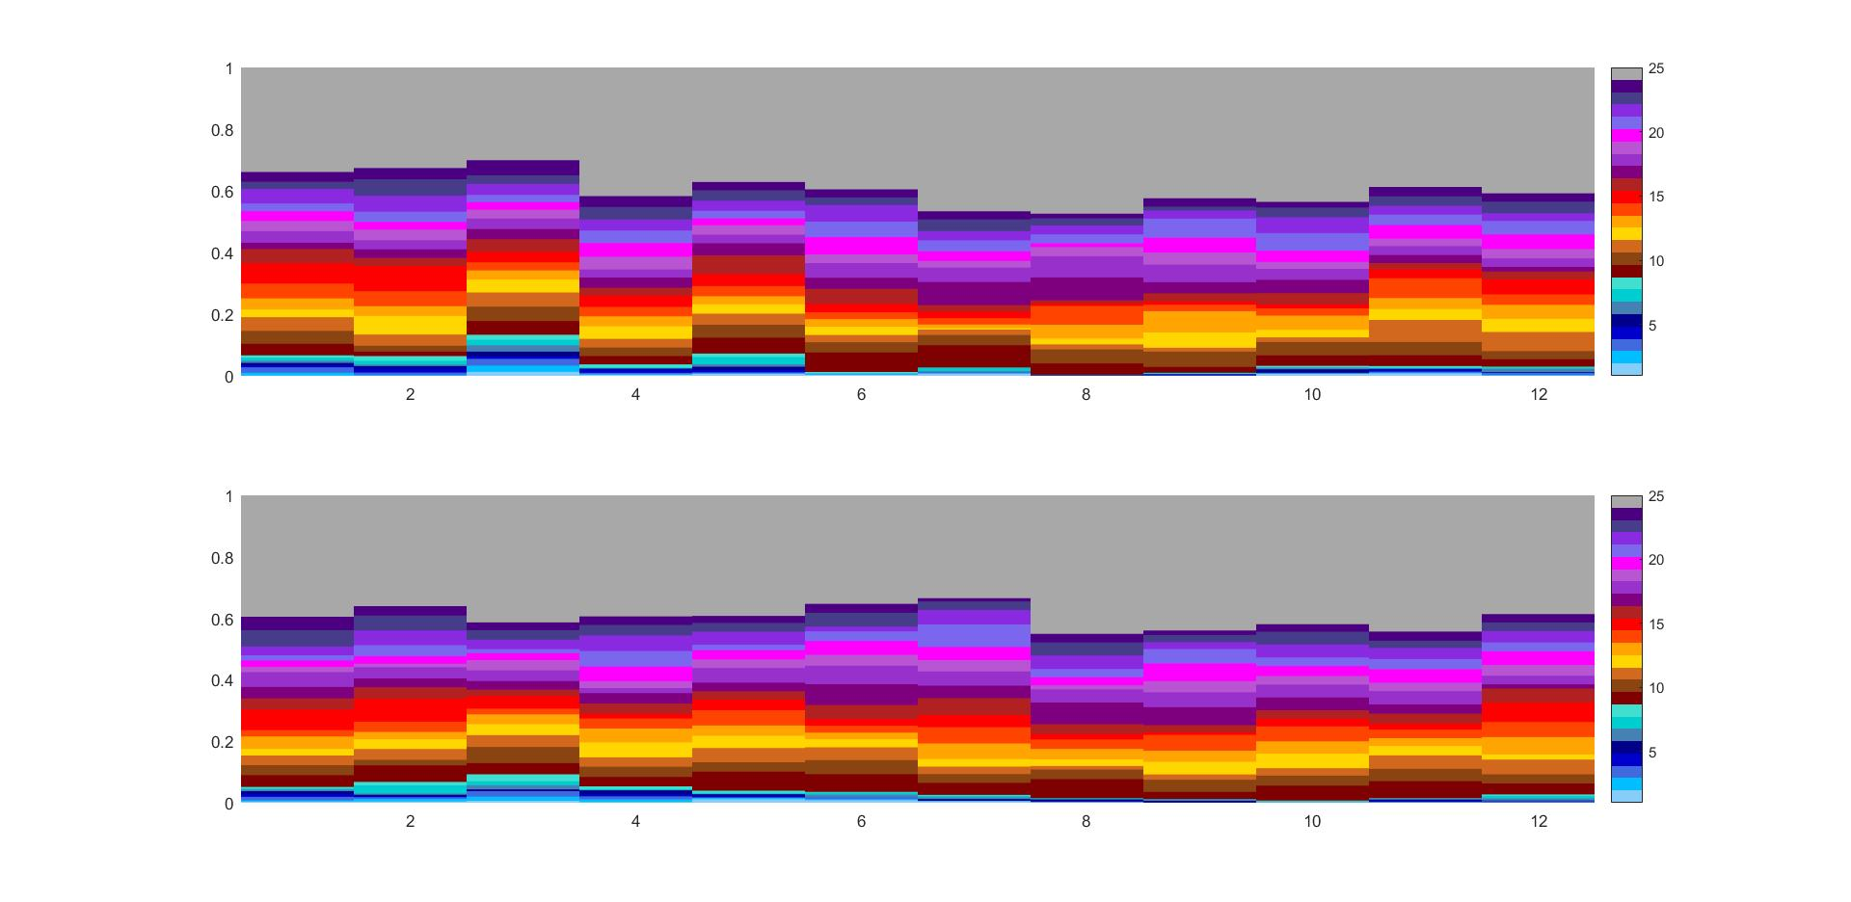
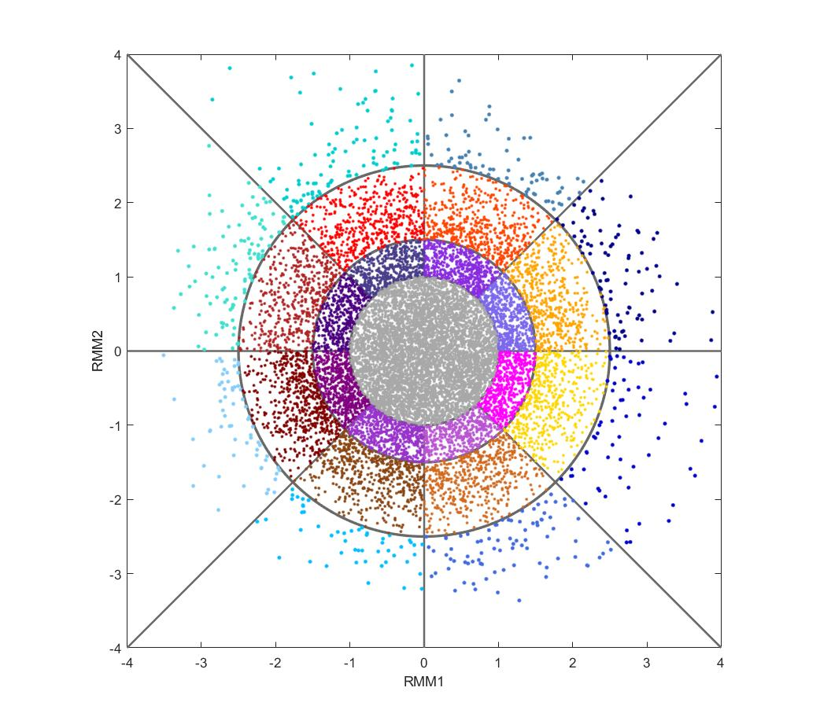
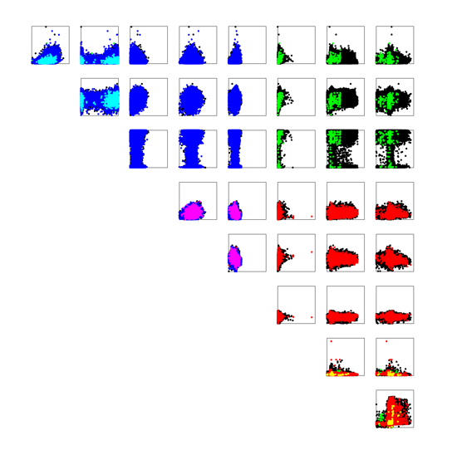
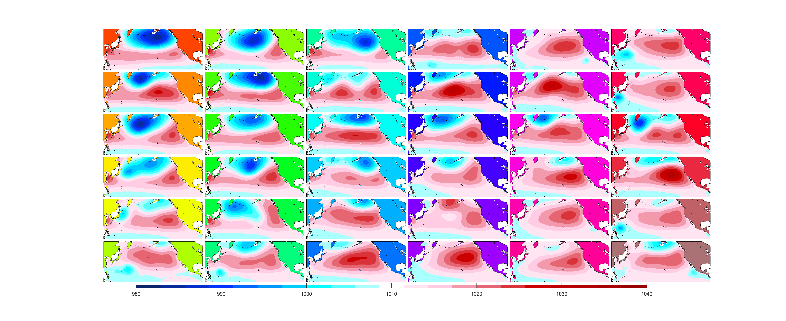
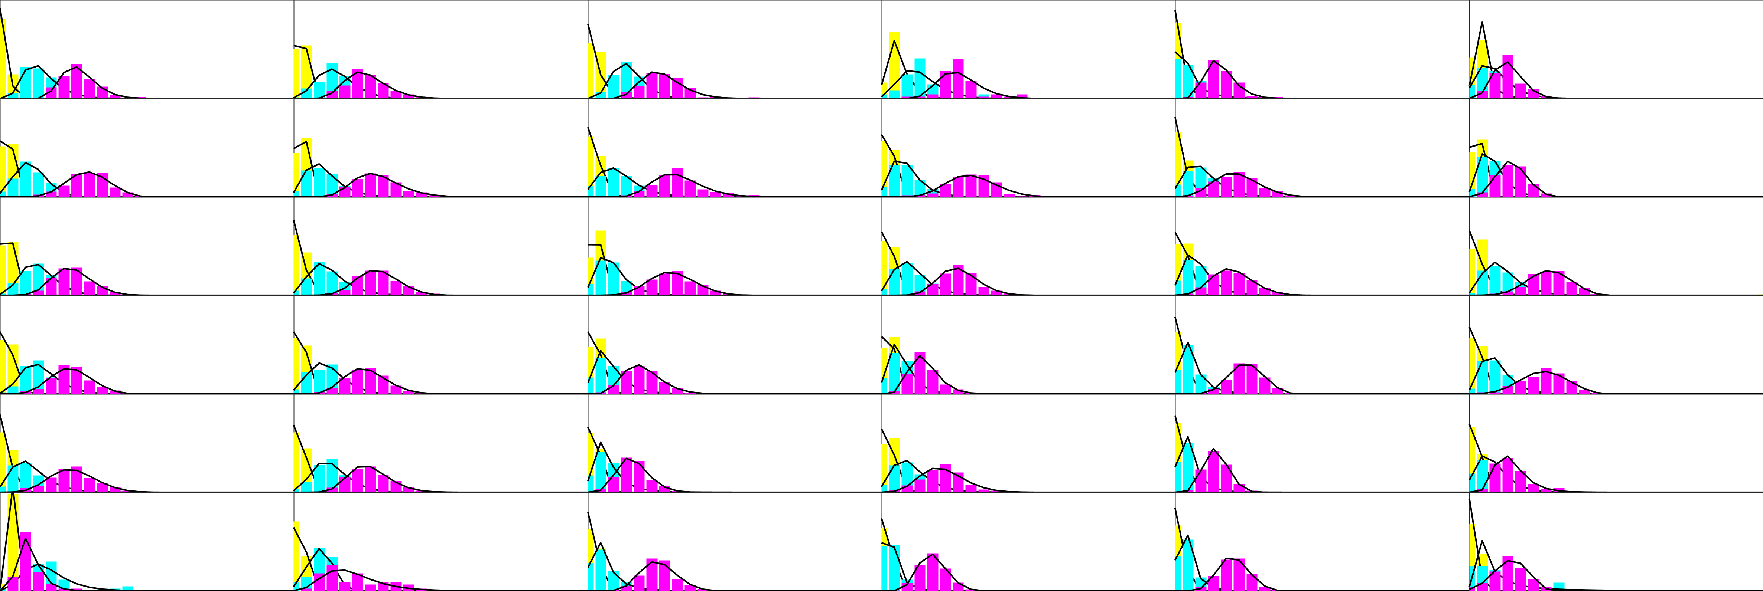
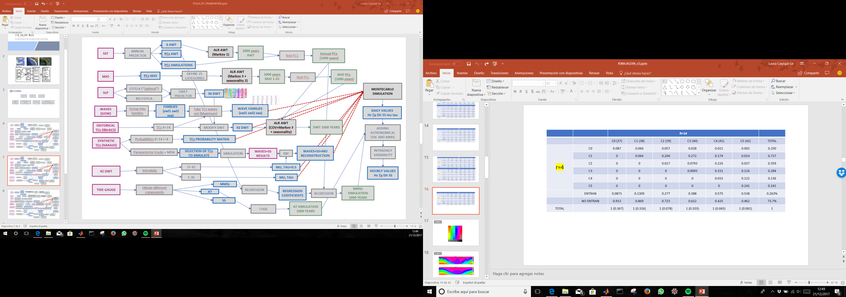
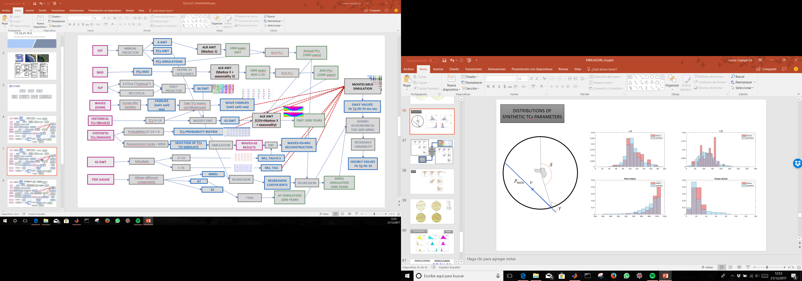
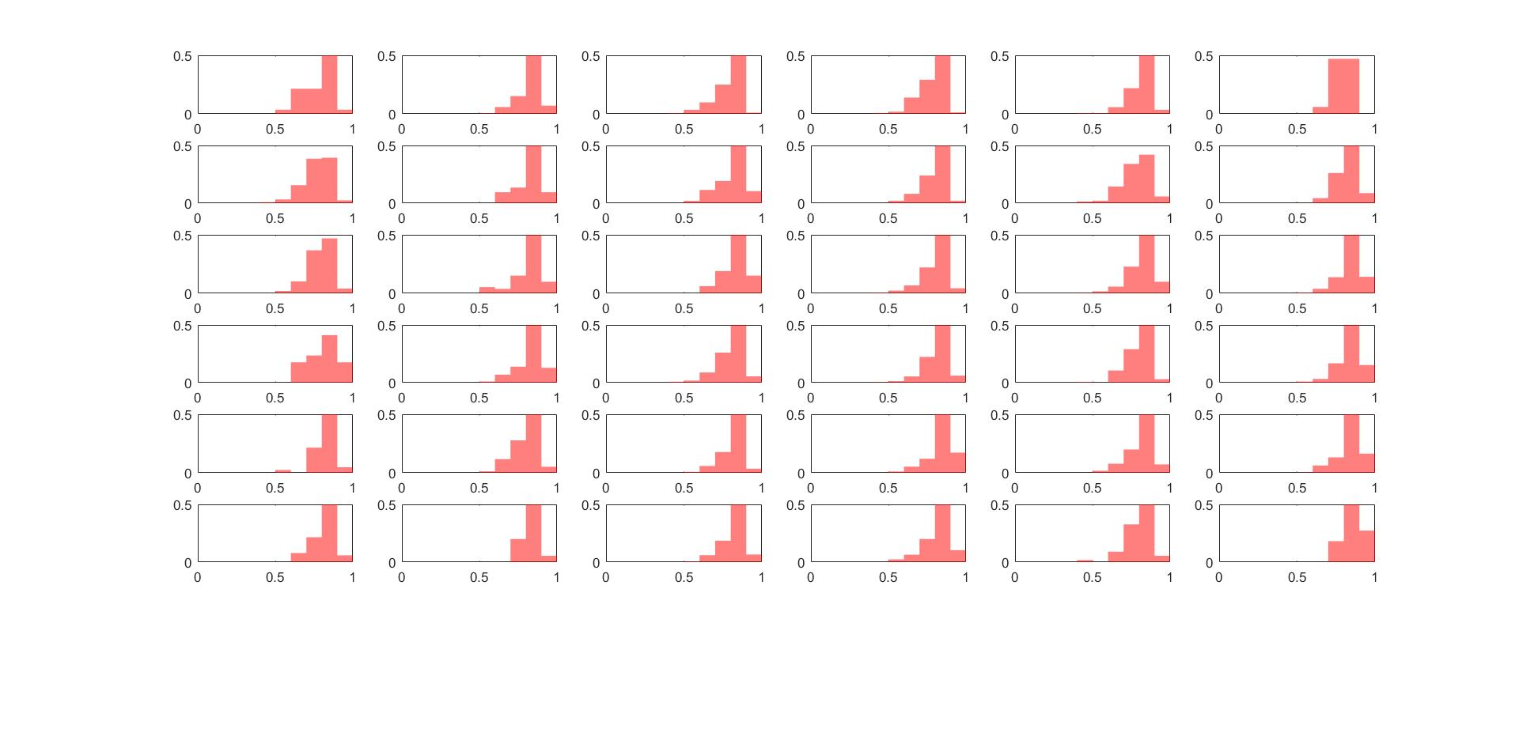
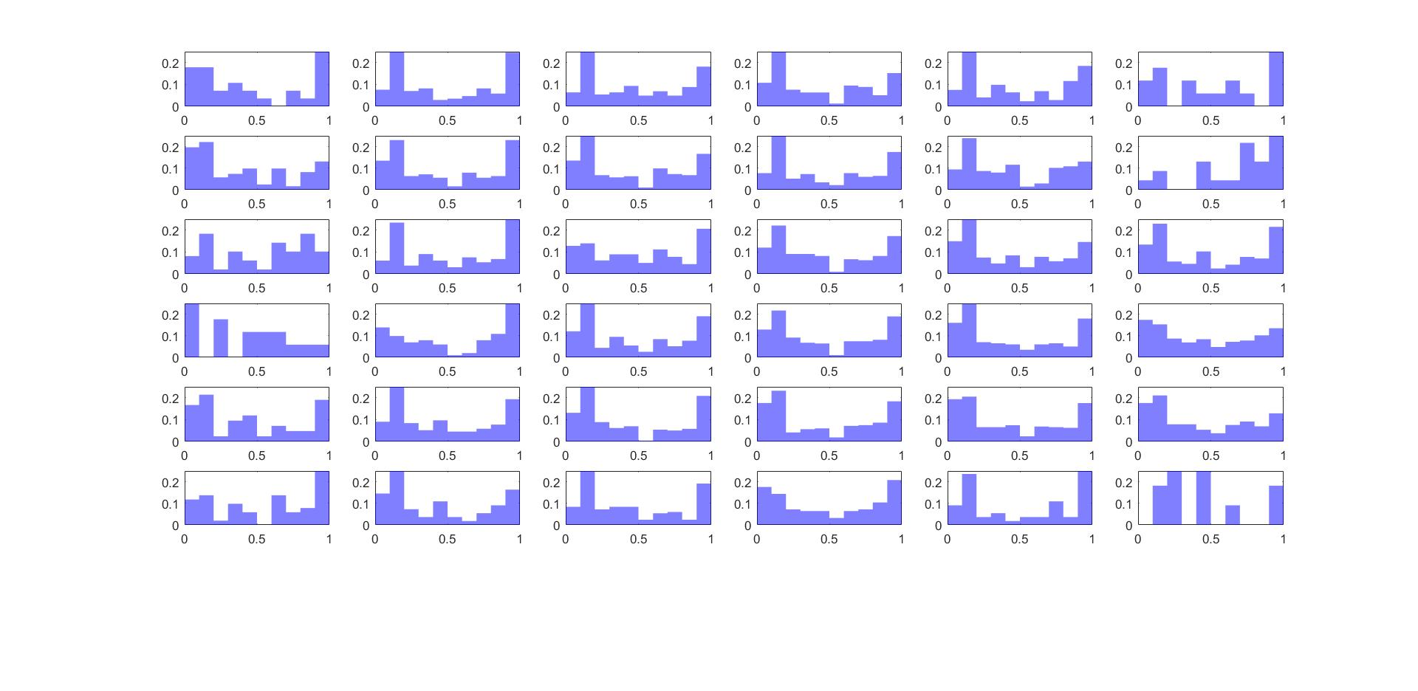
6 AWT
SST
ANNUAL PREDICTOR
ALR AWT
(Markov 1)
1000 years AWT
Annual PCs
(1000 years)
PCs AWT
Rnd PCs
PCs SIMULATIONS
MJO
PCs MJO
DEFINE 25 CATEGORIES
ALR AWT
(Markov 3 + seasonality 2)
1000 years MJO 1-25
MJO PCs
(1000 years)
Rnd PCs
ESTELA (“Optimal”)
MONTECARLO SIMULATION
SLP
DAILY
PREDICTOR
36 DWT
NO ESTELA
WAVES (GOW)
Group into families
FAMILIES
(swl1 swl2 sea)
Take TCs waves out (Maximum)
WAVE FAMILIES
(swl1 swl2 sea)
DAILY VALUES
Hs Tp Dir SS mu tau
HISTORICAL TCs (IBtrACS)
ALR AWT
(COV+Markov 3 + seasonality)
DWT 1000 YEARS
TCs R=14
MODIFY DWT
42 DWT
ADDING ASTRONOMICAL TIDE AND MMSL
SYNTHETIC TCs (NAKAJO)
Probabilities R=14 r=4
TCs PROBABILITY MATRIX
Parameterize tracks + MDA
SELECTION OF TCs TO SIMULATE
SIMULATION
WAVES+SS RESULTS
WAVES+SS+MU RECONSTRUCTION
INTRADAILY VARIABILITY
RBF
42 DWT
Intradaily
37-42
MU, TAU=0.5
HOURLY VALUES
Hs Tp Dir SS
1-36
MU, TAU
TIDE GAUGE
MMSL
Obtain different components
REGRESSION
REGRESSION COEFFICIENTS
MMSL SIMULATION 1000 YEARS
AT
REGRESSION
SS
TTIDE
AT SIMULATION 1000 YEARS

Slide 5
6 AWT
CODES
SST
ANNUAL PREDICTOR
DWT_prepareMJO_AWT_2parts.m (ALR Markov 1)
1000 years AWT
DWT_prepareMJO_AWT_2parts.m
PCs AWT
Annual PCs
(1000 years)
PCs SIMULATIONS
MJO
PCs MJO
MJO_ALR.m
DWT_prepareMJO_AWT_2parts.m (ALR Markov 3 + seasonality 2)
1000 years MJO 1-25
MJO PCs
(1000 years)
DWT_prepareMJO_AWT_2parts.m
ESTELA (“Optimal”)
MONTECARLO SIMULATION
F1c_Simulation_MaxStorm_1000years_v2.m
SLP
A1_Main_PCs_WTs.m
36 DWT
NO ESTELA
WAVES (GOW)
D2_WavesDistribution_partitions_V2.m
FAMILIES
(swl1 swl2 sea)
E5_Quitamos_olas_ciclones_máximo.m
WAVE FAMILIES TCs
(swl1 swl2 sea)
DAILY VALUES
Hs Tp Dir SS mu tau
HISTORICAL TCs (IBtrACS)
A1_SELECCIONO_CICLONES.m (14º)
DWT_prepareMJO_AWT_2parts.m(COV+Markov 3 + seasonality)
DWT 1000 YEARS
A2_QuitoTCs
42 DWT
ADDING ASTRONOMICAL TIDE AND MMSL
B1_Nakajo_tracks.m
B2_Probabilities_nakajo.m
TCs PROBABILITY MATRIX
SYNTHETIC TCs (NAKAJO)
SELECTION OF TCs TO SIMULATE
SIMULATION
WAVES+SS RESULTS
WAVES+SS+MU RECONSTRUCTION
INTRADAILY VARIABILITY
G3_TC1_Parametros_MDA.m
ReconstructionRBF_TCs.m
42 DWT
Intradaily
37-42
MU, TAU=0.5
HOURLY VALUES
Hs Tp Dir SS
1-36
MU, TAU
TIDE GAUGE
MMSL
Obtain different components
E1a_MMSL_KWA.m
REGRESSION COEFFICIENTS
MMSL SIMULATION 1000 YEARS
AT
E1a_MMSL_KWA.m
SS
E1_MareografoKWA.m
AT SIMULATION 1000 YEARS

